Slide 1
Which MLB team has the best fans
Project Title: Which MLB team has the best fanbase?
Team Members: Matt Galeski, Michael Joyce, Don Mudd
Data Used
https://www.baseball-reference.com/teams/STL/2019-schedule-scores.shtml
30 teams for 7 years – 210 individual seasons
2004, 2008, 2011, 2014, 2016, 2018, 2019
Individual game statistics.
US Metropolitan population – API
Statistics generated
Annual game attendance
Away game draw power
Game Attendance - Annual Game Average (Weekend / Weekday)
Chose not to further stratify by Day / Night or Day or week.
Attendance / Metro Population
Chose not to adjust for the 3 metro areas with 2 teams
Attendance / Wins
Notes:
1) No need to say any more
2) You will need to Fill all data gaps and then attempt to minimize the data limitations with the best solution and most time/cost effective Solution. Understand that an Excel gap filler can be quickly added or removed in contrast to typical System process changes.
3) BIG DATA could require special processing or rule out the entire project.
4, 5, 6) No comment required.

Slide 2
Which MLB team has the best fans
Data Analysis & Visualization Process
Manual: Data download.
Excel: MLB statistics data merger, cleansing & conversion to .csv.
Python: Metro population API call
Data merger & cleansing
Calculations
Charts
Tables
GitHub: Data storage & collaboration
Zoom: Collaboration
Slack: Collaboration
Notes:
1) No need to say any more
2) You will need to Fill all data gaps and then attempt to minimize the data limitations with the best solution and most time/cost effective Solution. Understand that an Excel gap filler can be quickly added or removed in contrast to typical System process changes.
3) BIG DATA could require special processing or rule out the entire project.
4, 5, 6) No comment required.

Slide 3
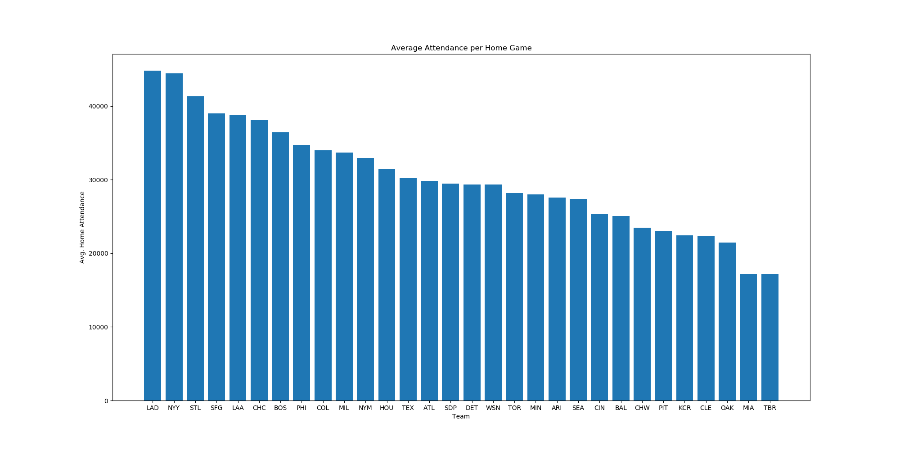
Which MLB team has the best fans
Annual Attendance per Team
Notes:
1) No need to say any more
2) You will need to Fill all data gaps and then attempt to minimize the data limitations with the best solution and most time/cost effective Solution. Understand that an Excel gap filler can be quickly added or removed in contrast to typical System process changes.
3) BIG DATA could require special processing or rule out the entire project.
4, 5, 6) No comment required.

Slide 4
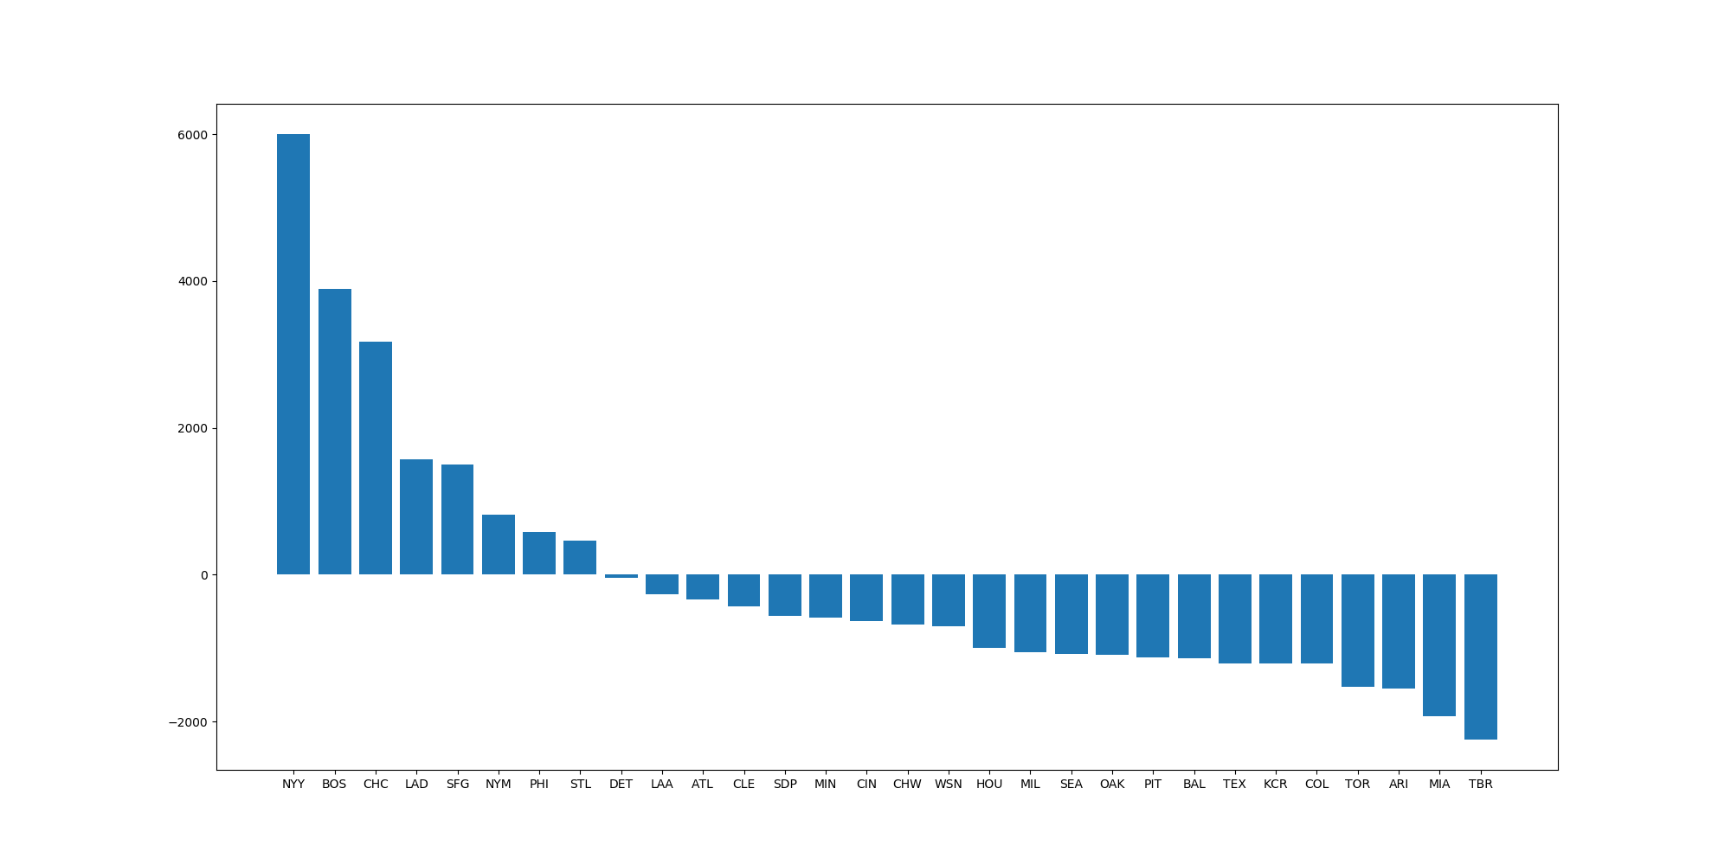
Which MLB team has the best fans
Away game draw power
Notes:
1) No need to say any more
2) You will need to Fill all data gaps and then attempt to minimize the data limitations with the best solution and most time/cost effective Solution. Understand that an Excel gap filler can be quickly added or removed in contrast to typical System process changes.
3) BIG DATA could require special processing or rule out the entire project.
4, 5, 6) No comment required.

Slide 5
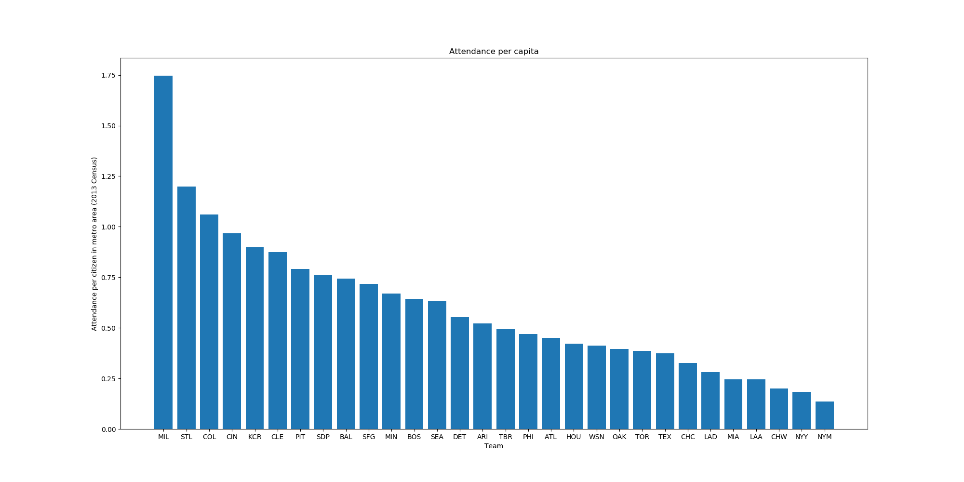
Which MLB team has the best fans
Attendance per capita
Notes:
1) No need to say any more
2) You will need to Fill all data gaps and then attempt to minimize the data limitations with the best solution and most time/cost effective Solution. Understand that an Excel gap filler can be quickly added or removed in contrast to typical System process changes.
3) BIG DATA could require special processing or rule out the entire project.
4, 5, 6) No comment required.

Slide 6
Which MLB team has the best fans
Avg Attendance / Wins
Notes:
1) No need to say any more
2) You will need to Fill all data gaps and then attempt to minimize the data limitations with the best solution and most time/cost effective Solution. Understand that an Excel gap filler can be quickly added or removed in contrast to typical System process changes.
3) BIG DATA could require special processing or rule out the entire project.
4, 5, 6) No comment required.

Slide 7
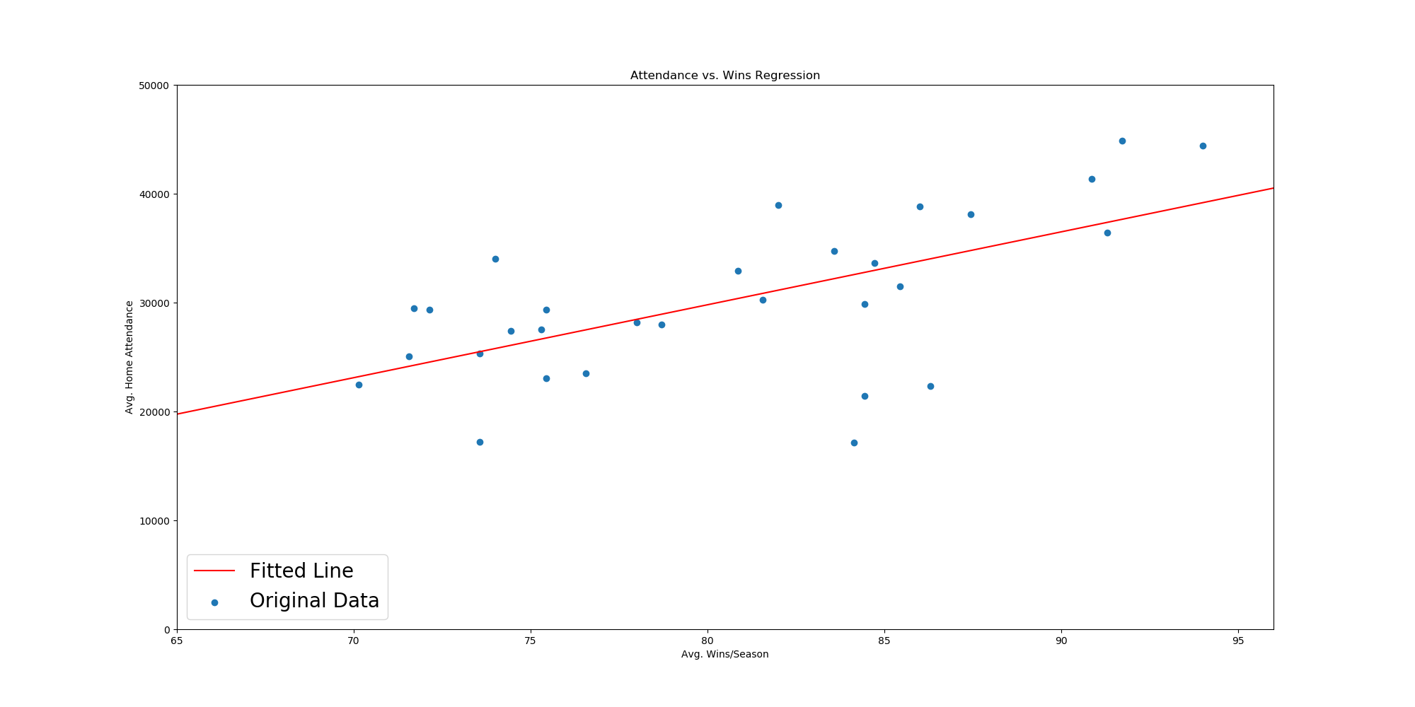
Which MLB team has the best fans
Attendance / Wins - Plot
Notes:
1) No need to say any more
2) You will need to Fill all data gaps and then attempt to minimize the data limitations with the best solution and most time/cost effective Solution. Understand that an Excel gap filler can be quickly added or removed in contrast to typical System process changes.
3) BIG DATA could require special processing or rule out the entire project.
4, 5, 6) No comment required.

Slide 8
Which MLB team has the best fans
Summary
The New York Yankees came out on top of fan attendance with both the Dodgers & Cardinals consistently in the top 3 in annual attendance.
The New York Yankees clearly have the best fans when it comes to “Away Game draw power
Larger metropolitan areas were found to consistently rank ahead of smaller metro areas!
The Milwaukee Brewers come in 1st when adjusting the attendance for the metropolitan area with the Cardinals coming in 2nd.
Teams from the larger metro areas came in toward the bottom
The Colorado Rockies and San Francisco Giants come in 1st and 2nd respectively when comparing avg attendance / wins.
Notes:
1) No need to say any more
2) You will need to Fill all data gaps and then attempt to minimize the data limitations with the best solution and most time/cost effective Solution. Understand that an Excel gap filler can be quickly added or removed in contrast to typical System process changes.
3) BIG DATA could require special processing or rule out the entire project.
4, 5, 6) No comment required.

Slide 9
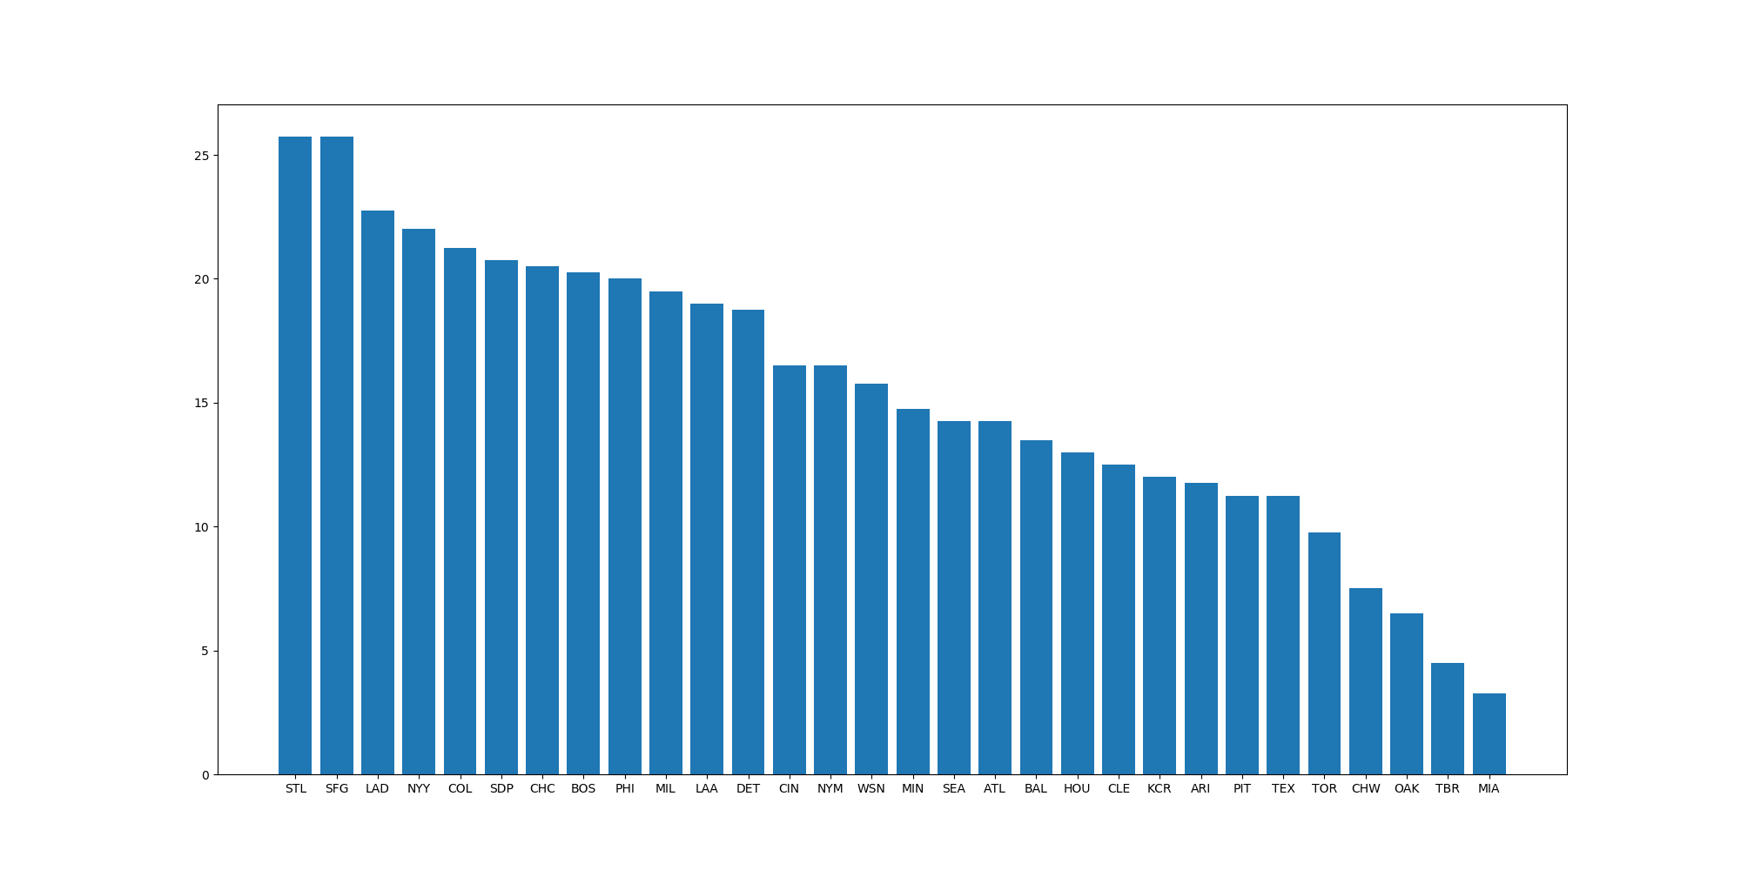
Which MLB team has the best fans
Final Fanbase Ranking
The St. Louis Cardinals do have the best fans in the MLB!
Notes:
1) No need to say any more
2) You will need to Fill all data gaps and then attempt to minimize the data limitations with the best solution and most time/cost effective Solution. Understand that an Excel gap filler can be quickly added or removed in contrast to typical System process changes.
3) BIG DATA could require special processing or rule out the entire project.
4, 5, 6) No comment required.

